Slide 1

SURPLUS FOOD MANAGEMENT ResQure
20 .05.2024
Team Member 1 : Mohanapriya E
Team Member 2 : Mukhilan S S
Team Member 3 : Nikhil P
MENTOR : Dr.P.Kumar, Professor
Dr. K.Ananthajothi M.E.,Ph.D.,

Slide 2
ABSTRACT
ResQure is a groundbreaking project aimed at addressing the dual challenges of urban food waste and food insecurity through the establishment of an innovative surplus food redistribution platform. Through advanced algorithms, real-time tracking, and community engagement, ResQure efficiently matches surplus food with recipient needs, minimizing waste and addressing hunger-related challenges. By harnessing the power of surplus food redistribution, ResQure aims to reduce food waste, alleviate hunger-related issues, and build a more equitable and resilient food system for communities worldwide.

Slide 3
PROPOSED SOLUTION
Digital Platform Development: Develop a user-friendly digital platform that serves as the central hub for surplus food redistribution. The platform should allow surplus food suppliers to easily list their excess inventory and enable recipients to submit specific requests based on their needs.
Integration of AI Algorithms: Incorporate advanced AI algorithms into the platform to optimize surplus food distribution. These algorithms will analyze surplus food listings and recipient requests in real-time, matching them based on factors such as proximity, quantity, and urgency to ensure efficient redistribution.
Real-Time Tracking and Transparency: Implement real-time tracking functionality on the platform, allowing users to monitor the status of their listings and requests throughout the redistribution process. This promotes transparency and accountability, building trust among users and stakeholders.

Slide 4
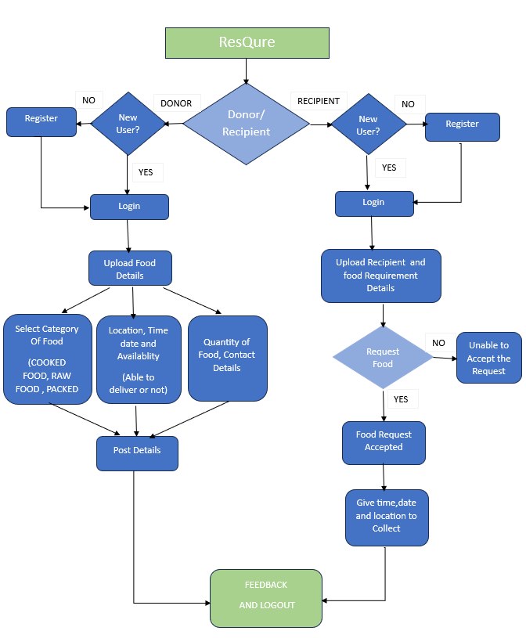

Slide 5
TECHNOLOGY USED
Backend Development:
Environemt: Node JS
Framework: Express js (for building applications)
Database: MongoDb (for storing data)
API Development: REST Framework (for building RESTful APIs)
Frontend Development:
Framework: Flutter(for building android applications)
Programming Language: Dart
UI Framework: Figma (for pre-built UI components)

Slide 6
NOVELTY
One unique aspect of this project is its innovative approach to surplus food redistribution through the integration of advanced technology, such as artificial intelligence (AI) algorithms, with Community-Based Organizations (CBOs) and Non-Governmental Organizations (NGOs)
Our algorithms analyze various factors, such as supply and demand, geographical location, and dietary preferences, to make data-driven decisions in real-time While by partnering with CBOs and NGOs, the project gains access to grassroots networks and local expertise, enhancing its reach and impact within communities.

Slide 7
SOCIAL RELEVANCE
The social relevance of the ResQure project is paramount, addressing critical issues that impact communities worldwide. At its core, ResQure tackles two interconnected challenges: food waste and food insecurity
Through innovative technology and grassroots partnerships, ResQure promotes a sense of solidarity and shared responsibility, building stronger, more resilient communities.
Ultimately, the social relevance of ResQure extends beyond mere food redistribution—it embodies a commitment to social justice, environmental sustainability, and human dignity, laying the foundation for a more inclusive and compassionate society.

Slide 8
REFERENCES
Smith, J., & Johnson, A. (2022). Optimizing surplus food redistribution using artificial intelligence algorithms. Food Security Journal, 8(3), 215-230. DOI:10.1007/s12571-022-02456-7
Sai Sushanth Nukala,Silva A. M. U. (2022). Developing Food Charity Operations Management System.
Food Recovery Network. (2020). Community-based strategies for surplus food redistribution. Food Recovery Network. https://www.foodrecoverynetwork.org/community-strategies
Aiello Giuseppe(2014). Economic benefits from food recovery at the retail stage: An application to Italian food chains
Bharani S; E. Mohanraj; Sujith M; Vinothkumar P. (2024). Optimizing Surplus Food Management: A User-Centric Application Approach

Slide 9
TOGETHER WE CAN TURN
EXCESS INTO SUCCESS

Slide 10

THANK YOU…

